Slide 1
Data Analysis
College Basketball
Brayden Uglione

Slide 2
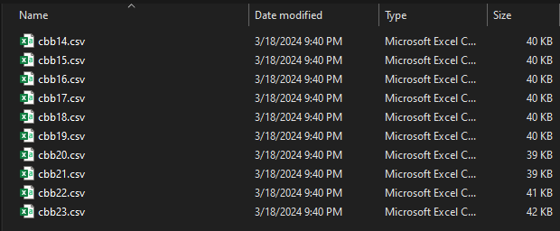
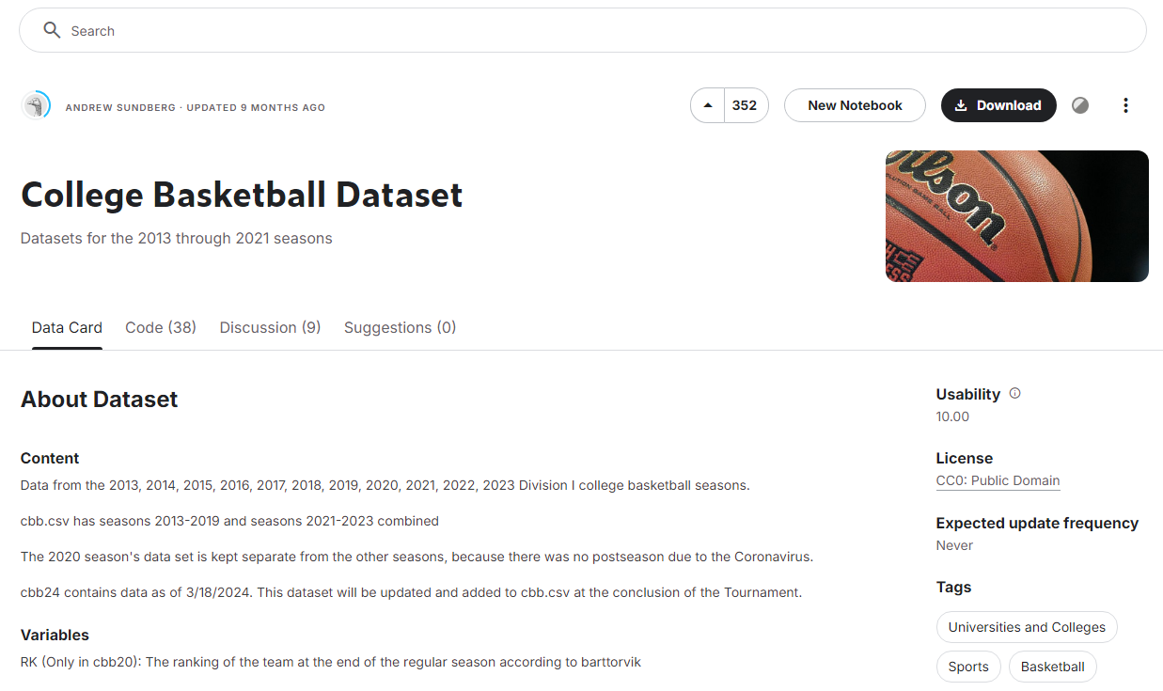
Dataset
College basketball statistics from 2014 - 2023
Source: Kaggle
10 CSV files, one per year

Slide 3
Questions Analyzed
01
02
03
04
05
How does a college basketball team's conference affect its power rating?
How has offensive efficiency changed over the past decade?
Does offense or defense have a greater impact on winning?
Do better teams less frequently turn over the ball?
How does the speed of college basketball teams affect their offense?

Slide 4
Benefits
Improve overall team performance
Develop effective game strategies against opponents
Enhance player skill development
Notes:
Mention how this will benefit coaching staff

Slide 5



Methodology
Python libraries
Data cleaning
Analysis
pandas, matplotlib, seaborn, numpy
removed unnecessary columns and rows
grouping, correlation, visualization
Notes:
Describe what each library is used for, what columns and rows I am removing, and what i am grouping (conferences) and correlating (winning percentage with offensive and defensive efficiency)

Slide 6
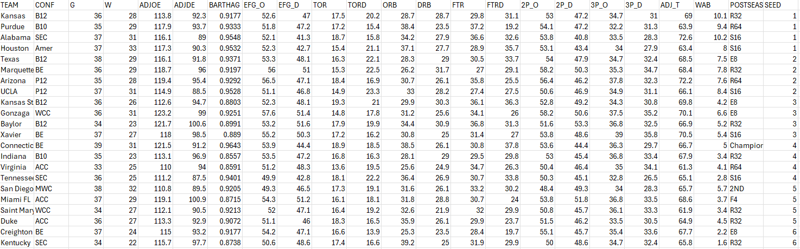
Sample of Data
Notes:
Briefly go over what columns represent

Slide 7
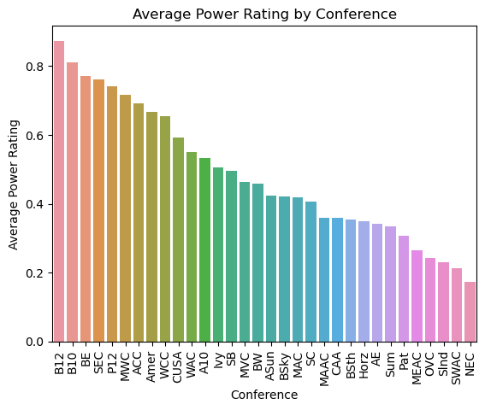
Results - Conference Power Ratings
Notes:
Talk about top 3 and bottom one (Northeast)

Slide 8
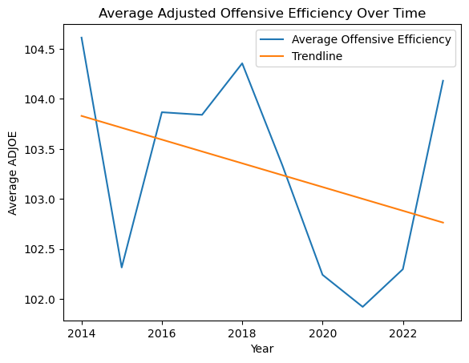
Results - Offensive Efficiency Trend
Notes:
Talk about fluctuations and surprising that it is decreasing

Slide 9
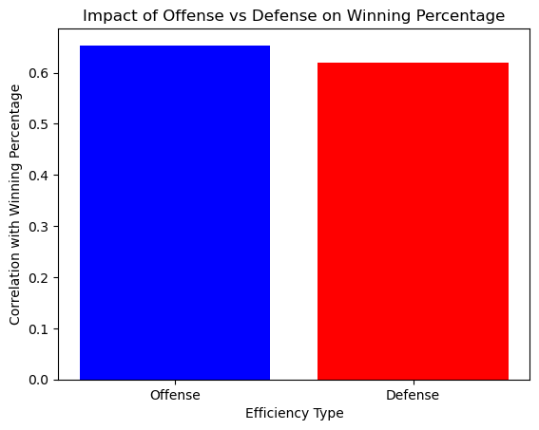
Offense vs Defense Impact

Slide 10
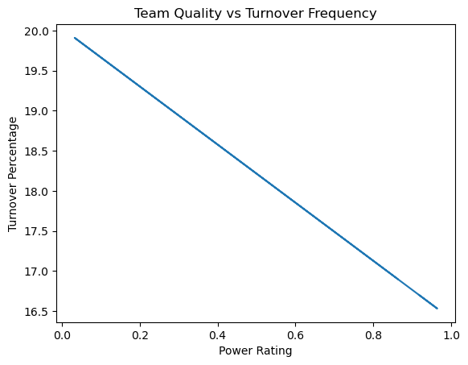
Team Quality vs Turnovers
Notes:
Talk about how it used to be a scatter plot but it was hard to look at (thats where numpy comes into play)

Slide 11
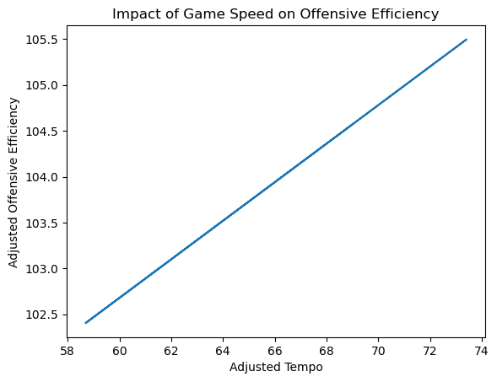
Game Speed vs Offensive Efficiency
Notes:
Same thing as previous slide

Slide 12
Conclusions
Big 12, Big Ten, Big East top conferences
Offensive efficiency declining over time
Offense more impactful than defense
Better teams have fewer turnovers
Faster tempo correlates with higher offensive efficiency

Slide 13



Recommendations for Coaches
Focus on offensive skill development
Implement more ball-handling drills to reduce turnovers
Consider adopting faster-paced playing styles
Notes:
Explain the why for each: 1. Offense more valuable than defense 2. Better teams turnover the ball less 3. Increased tempo results in more efficient offense

Slide 14



Future Work
Analyze postseason performance factors
Study individual player impacts on team success
Investigate position-specific contributions to efficiency
Notes:
Explain the why for each 1. Teams adjust their playing styles in the postseason 2. What player characteristics benefit and negate the team (shooting lots of shots, turning the ball over, etc.) 3. What should players prioritize in training based on their position

Slide 15
Questions?

Slide 16
Thank
You!

